Slide 1
Applied Data Science Capstone Presentation
IBM Data Science Professional Certificate
May 2025

Slide 2
Executive Summary
This presentation outlines the full Data Science workflow applied to a real-world problem, beginning with data collection from the SpaceX API and web scraping, followed by exploratory data analysis (EDA), data visualization, and predictive modeling.

Slide 3
Introduction
In this course I have applied and walked through in the following main steps:
Collecting data by requesting my response from SpaceX API
Dealing with missing values and filtering the needed subset of data
Collecting data by applying web scraping technique and dealing with HTML format to pandas
Performing EDA and some feature engineering to determine final labels
Illustrating visualizations and observing relationships among different features
Conducting different predictive analysis algorithms and evaluating models

Slide 4
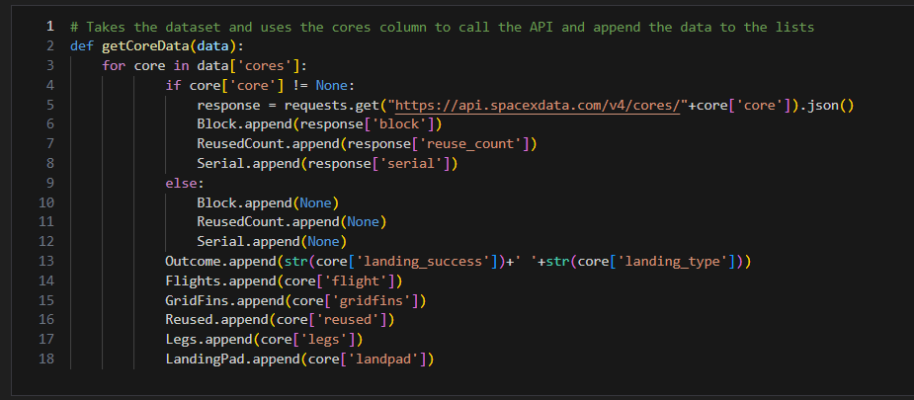
Data Collection and Wrangling Methodology
This is an example on how we interact with API requests. Here we are taking the dataset by using the cores column to append the data in lists.

Slide 5
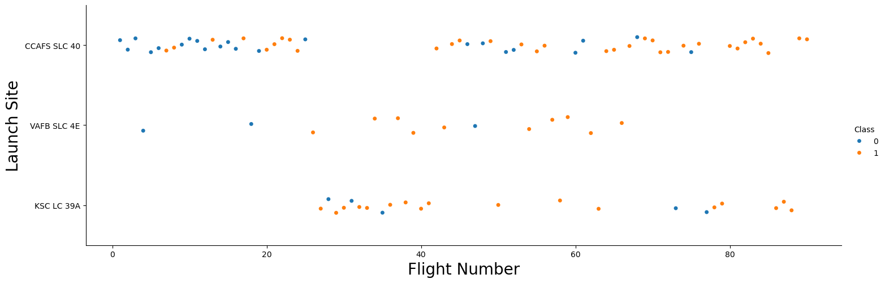
EDA & Interactive Visual Analytics Methodology
This is a scatter plot that shows the relationship between Flight Number and Launch site. Where we can conclude that Logistic Regression might be a very good starting algorithm to apply for predictive analysis

Slide 6
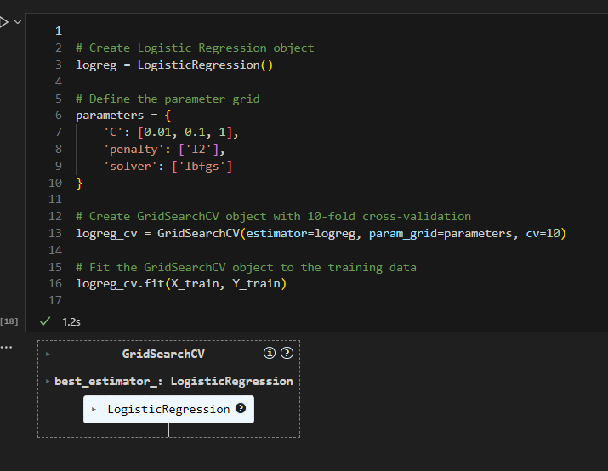
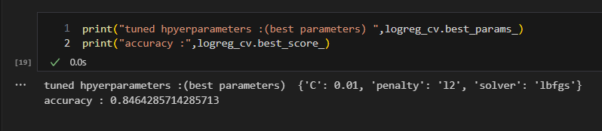
Predictive Analysis Methodology
The left image shows how we built a Logistic Regression Algorithm to be used in the predictive analysis.
The below image shows the evaluation metric, which is accuracy. Where we have 83%, which is a very good score that ensures we do not have overfitting and our models works well

Slide 7
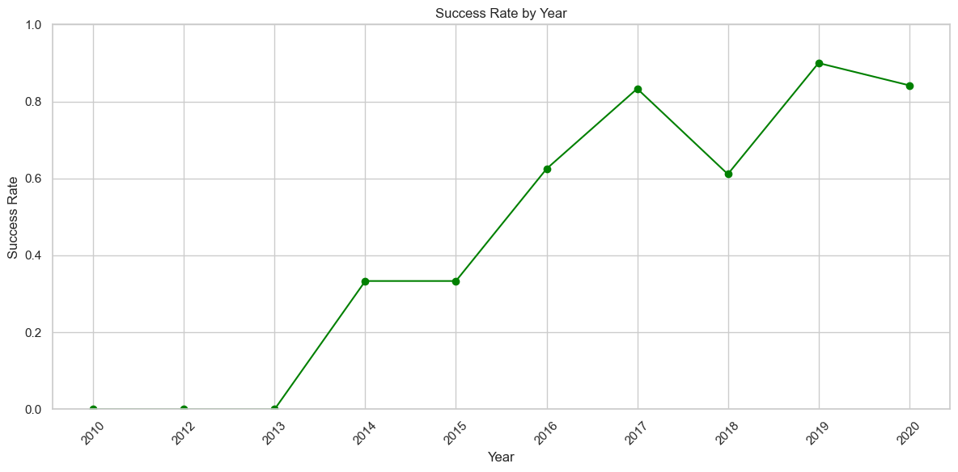
EDA with Visualization Results
One of the results we had after the Visualization EDA step is plotting the success rate for 10 years.
We can clearly observe the rate increases with time, which reflects correctly the learning curve theory where errors will be minimized by time

Slide 8
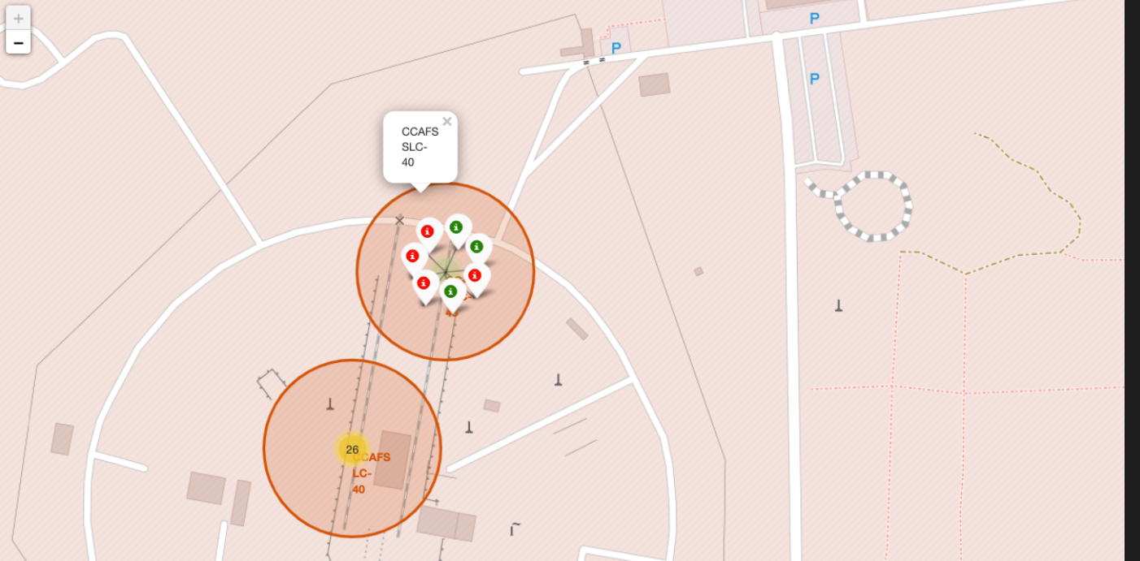
Interactive Map with Folium
The images shows an example of a folium code output, where we can mark for geospatial data analysis

Slide 9
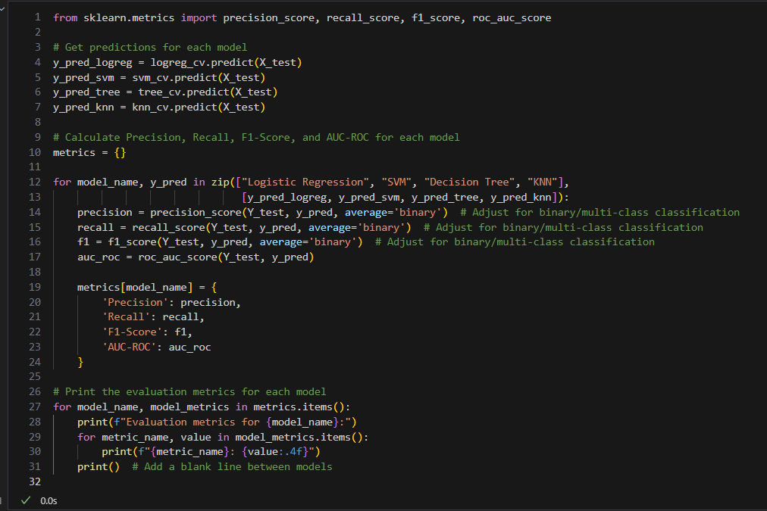
Predictive Analysis Results
Here I am sharing my code for the comparison I have made among the following predictive algorithms:
Logistic Regression
SVM
Decision Tree
And KNN
You can notice that I have used: Precision, Recall, F1-score, and AUC-ROC curve score to compare among these algorithms

Slide 10
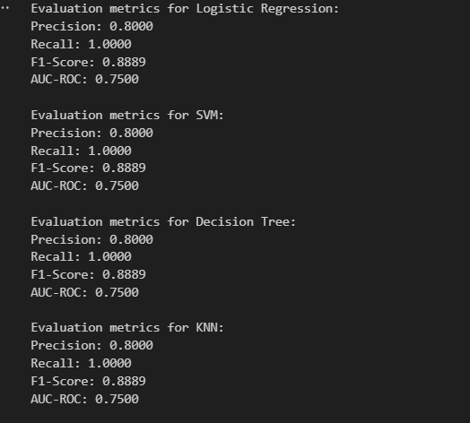
Predictive Analysis Results
I am surprised that all algorithms performed with identical evaluations metrics values.
I have reviewed my code many times ensuring I am not ding any mistake, but I came to the conclusion that my code is clean and the fact of identical values are true.
I left a comment in my notebook, that says that we may select the model based on the simplest and lightest one for the production and deployment steps

Slide 11
Conclusions
The project followed a structured Data Science pipeline: data ingestion via the SpaceX API and web scraping, preprocessing including null handling and feature selection, EDA and feature engineering for label construction, and applying multiple classification models (Logistic Regression, SVM, Decision Tree, KNN). Model evaluation was done using accuracy, precision, recall, F1-score, and AUC-ROC. Despite identical metrics across models, Logistic Regression was favored due to its simplicity and efficiency, aligning with deployment constraints.

Slide 12
Insights and Future Work
To enhance model performance and generalizability, future work could include hyperparameter tuning using GridSearchCV or RandomizedSearchCV, applying ensemble methods such as Random Forest or XGBoost, and incorporating additional features like payload mass, orbit type, or weather data via external APIs. Further, deploying the final model using Flask or Streamlit would enable real-time prediction capabilities and complete the MLOps cycle.

